Slide 1
Chapter 2 Database System Concepts and Architecture

Slide 2
Content
Data Model, Schema and Instance
Three schema architecture and data independence
Database languages & Interfaces
Database systems environment
Classification of DBMS

Slide 3
Data Models, Schemas, and Instances
Data abstraction : hiding the storage and data organization details & highlight essential features only.
data model—a concept that describes the structure of a database to achieve abstraction. Some data models also show manipulation operations.
Data Models can be divided into 3 categories:
Conceptual Data Model: defines WHAT the system contains.
entities, attributes & relationship
Created by stakeholders & data architects
Purpose: Create business rules
Logical Data Model: Defines HOW the system should be implemented regardless of the DBMS.
Done by BA and data architects
Physical Data Model: describes HOW the system will be implemented using a specific DBMS.
Create schemas , mappings
Created by DBA, developers
Actual implementation of DB

Slide 4
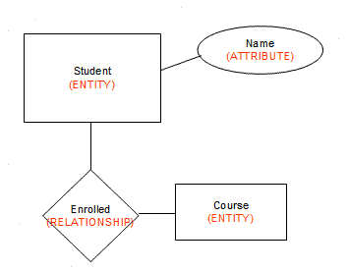
Data Models, Schemas, and Instances
Categories of Data Models:
High-level or conceptual data models such as entity–relationship model provide concepts that are easy for users to understand.
Conceptual data models use concepts such as entities, attributes, and relationships.
An entity represents a real-world object or concept, such as a student or a course.
An attribute further describes an entity, such as the student’s name or age.
A relationship among two or more entities represents an association among the entities, for example, a student is enrolled in a course.
Physical data models describe how data is stored as files in the computer by representing information such as record formats, record orderings, and access paths.

Slide 5
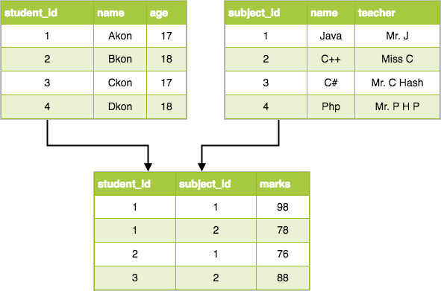
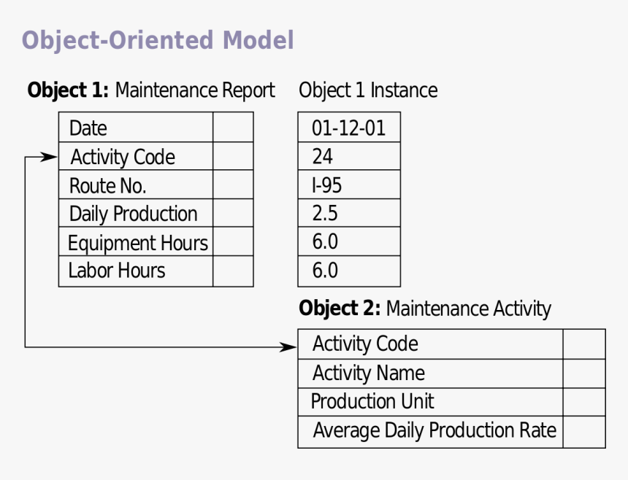
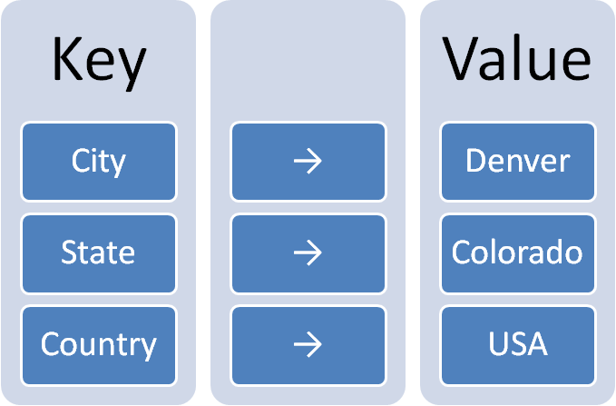
Data Models, Schemas, and Instances
Representational or implementation data models are used most frequently in traditional commercial DBMSs. These include the widely used relational data model.
Object data model is an example of a higher-level implementation data model that is closer to conceptual data models.
Self-describing data models - The data storage in these models combines the description of the data with the data values. These models include XML, key-value stores, and NOSQL systems

Slide 6
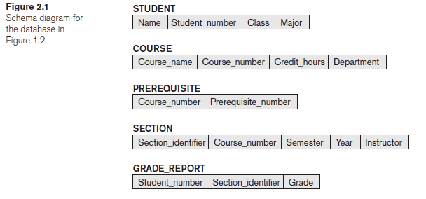
Data Models, Schemas, and Instances
Schemas, Instances, and Database State
The description of a database is called the database schema, which is specified during database design.
A displayed schema is called a schema diagram shown in figure. The diagram displays the structure of each record type but not the actual instances of records.
Each object in the schema—such as STUDENT or COURSE is a schema construct.
A schema diagram displays only some aspects of a schema, such as the names of record types and data items. Other aspects such as the data type of each data item nor the relationships among the various files are not specified.

Slide 7
Data Models, Schemas, and Instances
Schemas, Instances, and Database State
The actual data in a database may change quite frequently. For example, the database changes every time we add a new student or enter a new grade.
The data in the database at a particular moment in time is called a database state or snapshot.
Difference between database schema and database state.
When we define a new database, we specify its database schema only to the DBMS. At this point, the database state is the empty state.
Initial state - when the database is first populated with the initial data.
Current state – the state right now
Valid state — a state that satisfies the structure and constraints specified in the schema.
The schema is sometimes called the intension, and a database state is called an extension of the schema.
Instance – an individual record in a database
Schema evolution – very rare, but needed because of change in business requirements.

Slide 8
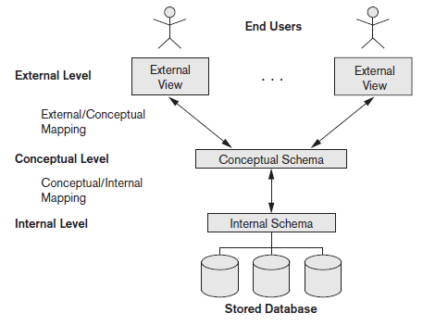
Three schema architecture and data independence
The Three-Schema Architecture
The goal of the three-schema architecture is data abstraction from user, i.e., user is independent of how & where data is stored.
Internal Level - The internal level has an internal schema, which describes the physical storage structure of the database.
The internal schema uses a physical data model and describes the complete details of data storage and access paths for the database.
Conceptual level - The conceptual level has a conceptual schema, which describes the structure of the whole database.
The conceptual schema hides the details of physical storage structures and concentrates on describing entities, data types, relationships, user operations, and constraints. e.g., ER model.
External level - The external or view level includes a number of external schemas or user views depending on user roles.
Each external schema describes the part of the database that a particular user group is interested in and hides the rest of the database from that user group.
The three schemas are only descriptions of data; the actual data is stored at the physical level only.

Slide 9
Three schema architecture and data independence
The Three-Schema Architecture
Request specified
on an external schema
The processes of transforming
requests and results between levels are called mappings.
Request transformed into conceptual schema
Request transformed into internal schema
Processing

Slide 10
Three schema architecture and data independence
Data Independence
Data independence – the capacity to change the schema at one level of a database system without having to change the schema at the next higher level.
Logical data independence is the capacity to change the conceptual schema without having to change external schemas .
We may change the conceptual schema (by adding a record type or data item), to change constraints, or to reduce the database (by removing a record type or data item).
After the conceptual schema changes, application programs that reference the external schema constructs must work as before.
Changes to constraints can be applied to the conceptual schema without affecting the external schemas or application programs.

Slide 11
Three schema architecture and data independence
Data Independence
Physical data independence is the capacity to change the internal schema without having to change the conceptual schema. Hence, the external schemas need not be changed as well.
Changes to the internal schema may be needed because some physical files were reorganized—for example, by creating additional access structures—to improve the performance of retrieval or update.
If the same data as before remains in the database, we should not have to change the conceptual schema.
Like changing file location/access paths, compressing and saving data records.
Which data independence is harder to achieve? Physical or logical? Why?
logical independence is difficult to achieve

